Slide 1
Database Connectivity

Slide 2
MySQLi Object-Oriented
<?php $servername = "localhost"; $username = "username"; $password = "password"; // Create connection $conn = new mysqli($servername, $username, $password); // Check connection if ($conn->connect_error) { die("Connection failed: " . $conn->connect_error); } echo "Connected successfully"; ?>
OUTPUT:
Connected successfully

Slide 3
MySQLi Procedural
<?php $servername = "localhost"; $username = "username"; $password = "password"; // Create connection $conn = mysqli_connect($servername, $username, $password); // Check connection if (!$conn)
{
die("Connection failed: " . mysqli_connect_error()); } echo "Connected successfully"; ?>
OUTPUT:
Connected successfully

Slide 4
PDO
// set the PDO error mode to exception $conn->setAttribute(PDO::ATTR_ERRMODE, PDO::ERRMODE_EXCEPTION); echo "Connected successfully"; } catch(PDOException $e) { echo "Connection failed: " . $e->getMessage(); } ?>
OUTPUT:
Connected successfully
PDO - PHP Data Objects - is a database access layer providing a uniform method of access to multiple databases. It doesn't account for database-specific syntax, but can allow for the process of switching databases and platforms to be fairly painless, simply by switching the connection string in many instances.
<?php $servername = "localhost"; $username = "username"; $password = "password";
try { $conn = new PDO("mysql:host=$servername;dbname=myDB", $username, $password);

Slide 5
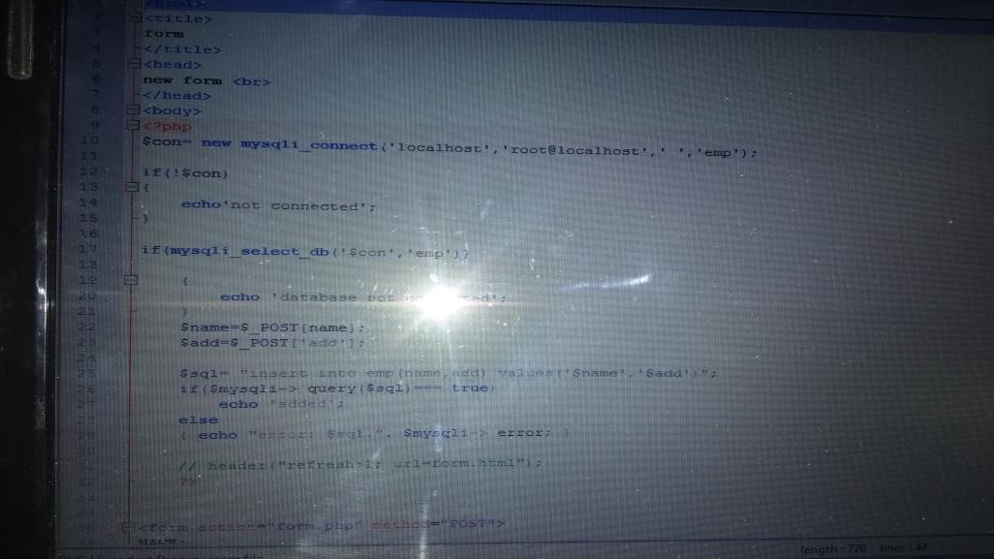

Slide 6
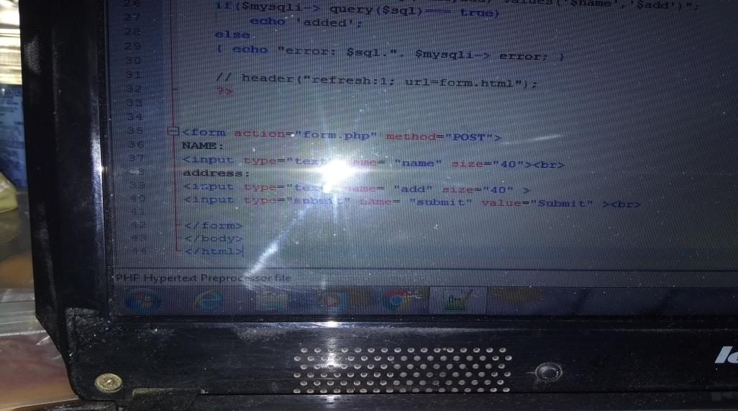

Slide 7
